Slide 1
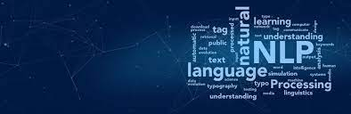



B.Tech Sem-VII Prof. Shirin matwankar
Natural Language Processing

Slide 2
Module 2- Text Processing and Word-Level Analysis

Slide 3
Note: The problems have been solved in the notebook. Please refer to it.

Slide 4
Lexical Analysis — What and Why
Before any NLP task, the machine must answer: what is a word? That question is harder than it sounds.
Lexeme
The abstract unit of meaning — the dictionary entry.
Example: RUN is one lexeme.
Token
A single occurrence of a word in text.
'run', 'ran', 'running' → 3 tokens, 1 lexeme.
Type
A unique token form in the vocabulary.
'the the the' → 3 tokens, 1 type.
Corpus
A collection of text used for NLP.
Example: Wikipedia, Twitter data, legal documents.
Key insight: NLP works at the TOKEN level, not the LEXEME level. This is why 'run' and 'running' are treated differently without morphological analysis.
Notes:
Ask students: how many words are in the sentence 'The cat sat on the mat'? They say 6. Then ask: how many unique words? They say 5 ('the' appears twice). That's the token vs type distinction.

Slide 5
Lexical Analysis — Example
"The cat sat on the mat. The cat is fat."
Total Tokens
10
Every word occurrence including duplicates
Unique Types
7 (the, cat, sat, on, mat, is, fat)
'the' and 'cat' appear twice — counted once
Lexemes
7 (same here — no inflections yet)
Would differ if we had 'cats' → lexeme = 'cat'
Type-Token Ratio
7 / 10 = 0.70
Higher ratio = more vocabulary diversity
Vocabulary Size
|V| = 7
Grows with corpus size — Heap's Law (Topic 2.2)

Slide 6
Lexical Analysis — Colab Demo
DEMO
import nltk
from nltk.tokenize import word_tokenize
nltk.download('punkt')
text = "The cat sat on the mat. The cat is fat."
tokens = word_tokenize(text.lower())
# Tokens vs Types
print('Total Tokens:', len(tokens))
print('Unique Types:', len(set(tokens)))
print('Type-Token Ratio:', round(len(set(tokens))/len(tokens), 2))
# Frequency distribution
from nltk import FreqDist
fd = FreqDist(tokens)
print('Most common:', fd.most_common(5))
# Vocabulary size
print('Vocabulary |V|:', len(fd))

Slide 7
Lexical Analysis — Discuss
❓ Why does token vs type distinction matter for NLP?
→ A model treating 'run' and 'ran' as different types loses the semantic connection. Morphological analysis (Topic 2.4) solves this by mapping both to lexeme 'run'.
❓ What happens to vocabulary size as corpus grows?
→ It grows — but slower than linearly.
❓ How does your project domain affect vocabulary size?
→ Technical domains (medical, legal) have large specialized vocabularies. Social media has massive informal vocabulary. Both need different preprocessing strategies.
❓ Market relevance — where does lexical analysis appear?
→ Spell checkers, autocomplete, search indexing, dictionary apps. Every NLP product starts here. Getting this wrong breaks everything downstream.

Slide 8
Empirical Laws — What Nature Tells Us About Language
Before building any NLP system, we must understand the statistical nature of text. Two laws govern it.
Zipf's Law
Heap's Law
Frequency of a word is inversely proportional to its rank.
Vocabulary size grows as a power function of corpus size.
frequency(w) ∝ 1 / rank(w)
|V| = K × N^β (β ≈ 0.4–0.6)
Rank 1: 'the' → appears ~7% of all words
|V| = vocabulary size
Rank 2: 'of' → appears ~3.5%
N = number of tokens in corpus
Rank 3: 'and' → appears ~2.8%
K, β = corpus-specific constants
Rank 10: 'in' → appears ~1%
β ≈ 0.5 for most English corpora
Rank 100 onwards → very rare words
As N doubles → |V| grows by ~40%
Implication: A few words dominate text. → Stop word removal.
Implication: Vocabulary never saturates. → Open vocabulary problem.
Notes:
Show a log-log plot of Zipf's law on the board — it becomes a straight line. Ask: why is this useful for NLP engineers? Answer: it tells us that stop word removal will eliminate a huge fraction of text with very few words removed.

Slide 9
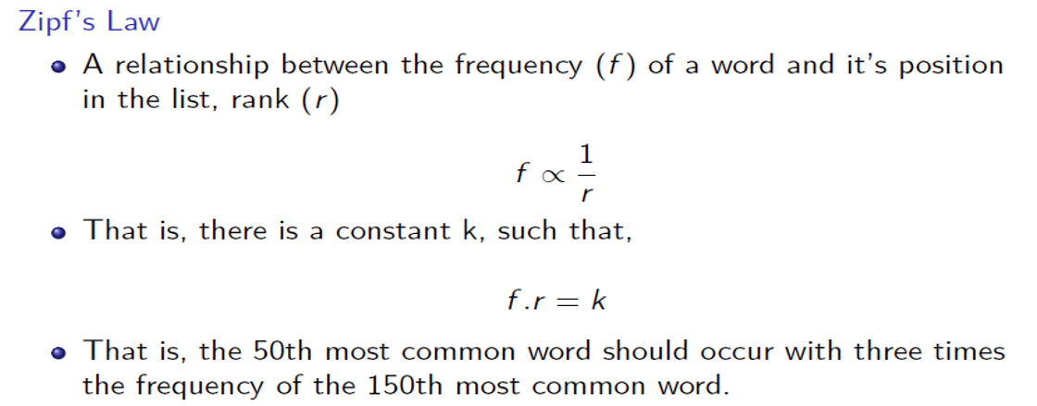
Zipf's Law — Mathematical Formulation
MATH
Zipf's Law gives us the first mathematical insight into why preprocessing decisions are justified.
Why does this matter for preprocessing?
Top 100 words cover ~50% of all text
→ Stop word removal eliminates half the text with 100 rules
Most words are very rare (long tail)
→ Rare words need smoothing — seen in test but not training
Vocabulary grows unboundedly
→ Subword tokenization (BPE) handles unseen words in BERT/GPT

Slide 10
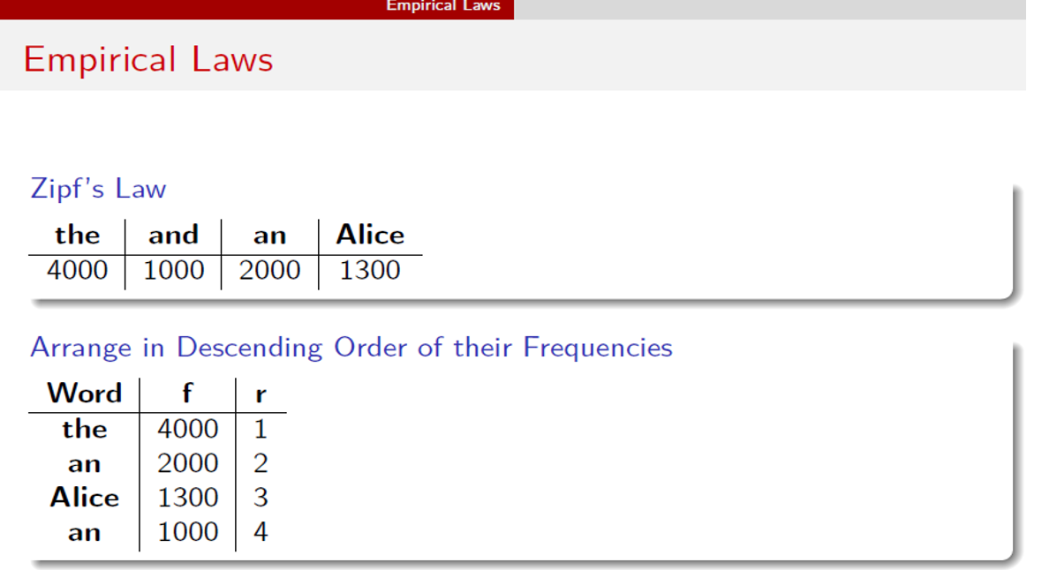

Slide 11
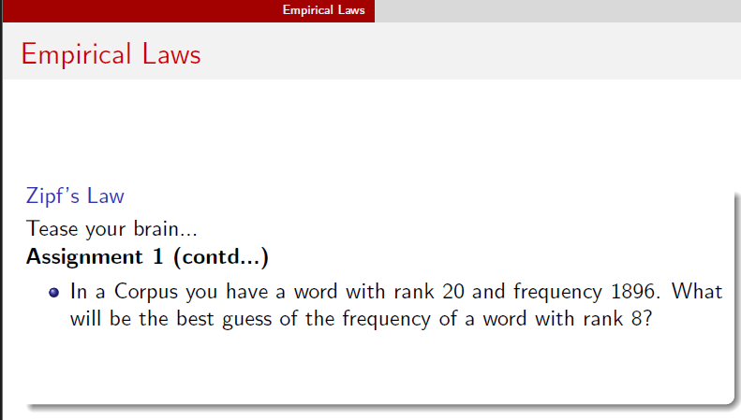

Slide 12
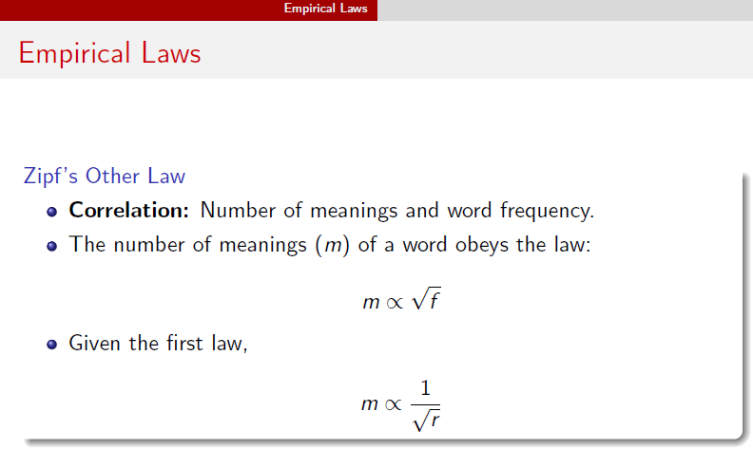

Slide 13
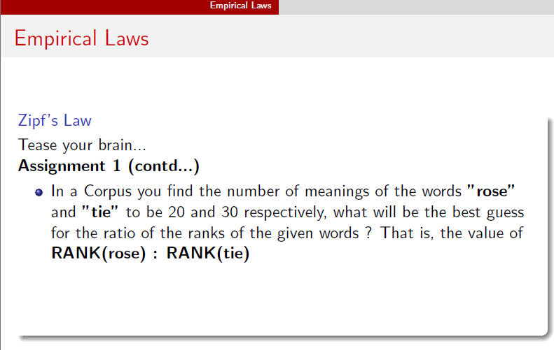

Slide 14
Empirical Laws — Verify on Real Text
DEMO
import nltk, math
from nltk.corpus import gutenberg
from nltk import FreqDist
Observe: rank × frequency ≈ constant across all ranks → Zipf's Law confirmed. Try with your own project dataset.
nltk.download('gutenberg')
# Load a real corpus — Shakespeare
words = gutenberg.words('shakespeare-hamlet.txt')
words = [w.lower() for w in words if w.isalpha()]
# Zipf's Law — rank vs frequency
fd = FreqDist(words)
ranked = fd.most_common()
print('Rank 1:', ranked[0]) # most frequent word
print('Rank 2:', ranked[1])
print('Rank 10:', ranked[9])
# Verify: rank × frequency ≈ constant?
for rank, (word, freq) in enumerate(ranked[:5], 1):
print(f'Rank {rank}: {word:10} freq={freq:4} rank×freq={rank*freq}')

Slide 15
Empirical Laws — Discuss
DISCUSS
❓ Why does Zipf's Law justify stop word removal?
→ Top 100 words cover ~50% of all text but carry almost no meaning. Removing them reduces noise dramatically with minimal information loss.
❓ What does Heap's Law tell a system designer?
→ You can never have a complete vocabulary. New words always appear.
❓ Do these laws hold for Indian languages?
→ Approximately yes — but with different constants. Morphologically rich languages like Marathi have sparser distributions because one concept maps to many word forms.
❓ Alternative view — do these laws always hold?
→ Social media text, code, and highly technical domains show deviations. Zipf's Law is empirical, not universal. Always verify on your specific corpus.

Slide 16
Basic terms of text processing

Slide 17
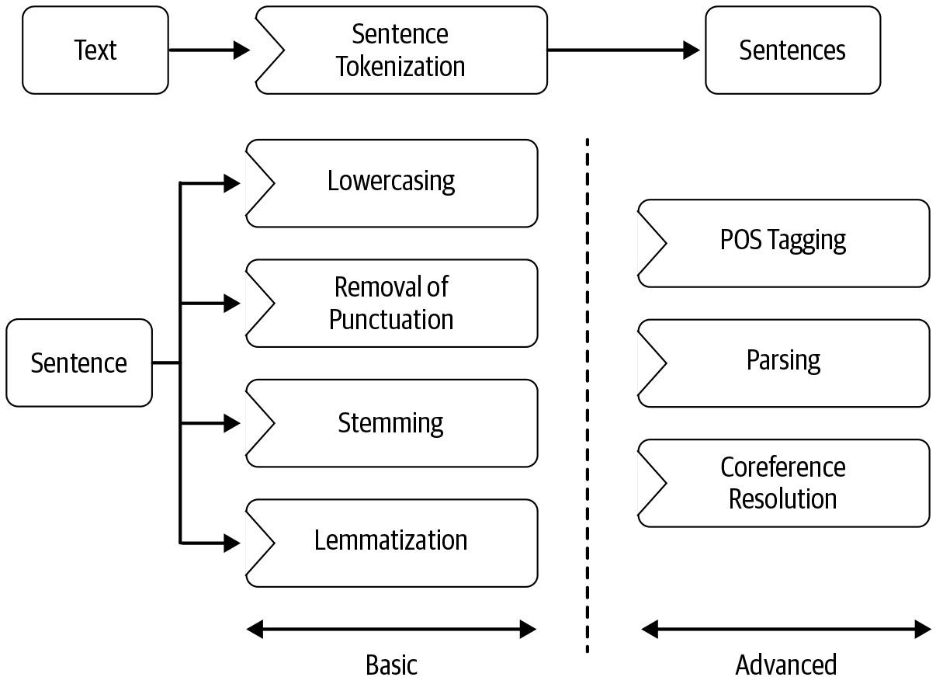
Pre-Processing Steps

Slide 18
Steps of NLP
Sentence Segmentation
Word Tokenization
Stemming
POS tags
Lemmatization
Identifying Stop Words
Dependency Parsing
Noun phrases
Named Entity Recognition (NER)
Coreference resolution
Chunking

Slide 19
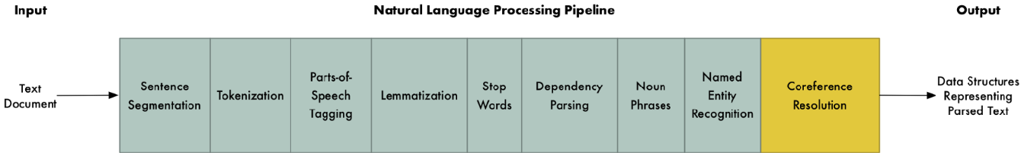

Slide 20
Sentence Segmentation
The problem of deciding where the sentences begin and end.
Challenges involved
While ‘!’ , ‘?’ are quite unambiguous
Periods “.” is quite ambiguous and can be used additionally for Abbreviations (Dr. , Mr.)
Numbers (2.3%, 7.9)
Approach : Build a binary classifier
For each “.” : Decides EndOfSentence/NotEndOfSentense
Classifiers can be: hand- written rules, regular expressions or machine learning classifiers

Slide 21
Word Tokenization
Tokenization is the process of segmenting a string of characters into words.
How many words?
Word token : An occurrence of a word or instance of type in running text
Word type: element of vocabulary
Example:
I have a can opener; but I can’t open these cans.
Word token: 11
Word type: 10
Word tokenization is also called as word segmentation.

Slide 22
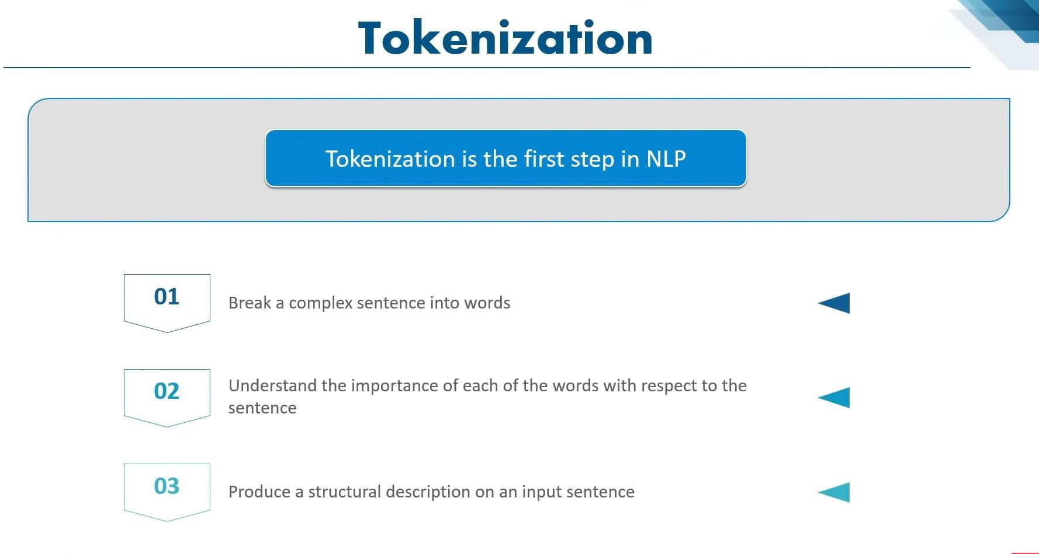

Slide 23

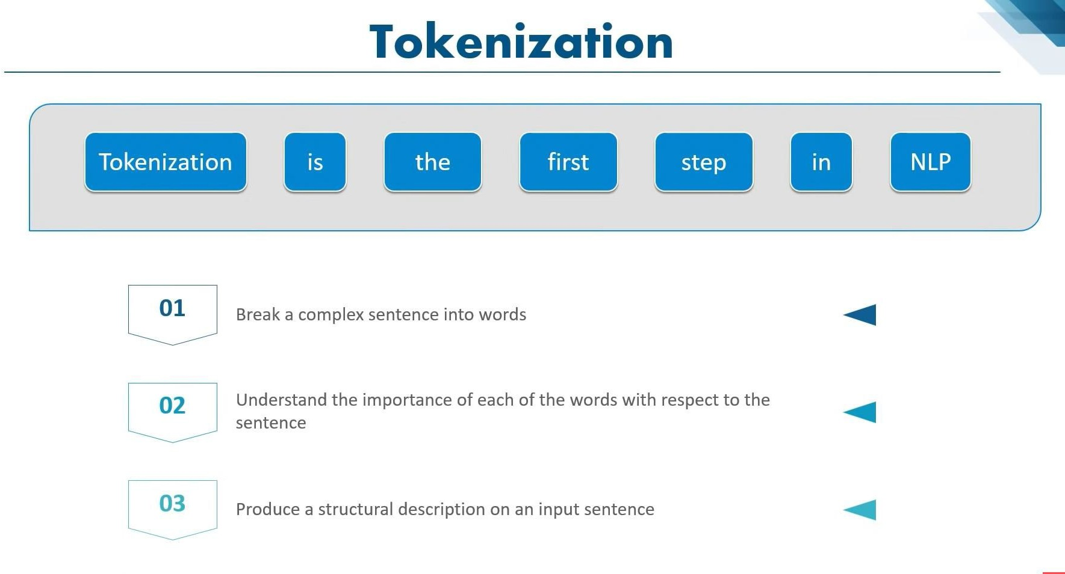

Slide 24
Issues in word Tokenization
Finland’s -> Finland Finlands Finland’s
What’re, I’m, shouldn’t->What are, I am, should not
San Francisco-> one or two tokens?
Handling Hyphens->show-time, hand- delivered, five-to-six, co-,multi-,meta-
Language specific issues-
French
L'ensemble → one token or two?
L ? L’ ? Le ?
Want l’ensemble to match with un ensemble
German noun compounds are not segmented
Lebensversicherungsgesellschaftsangestellter
‘life insurance company employee’
German information retrieval needs compound splitter

Slide 25
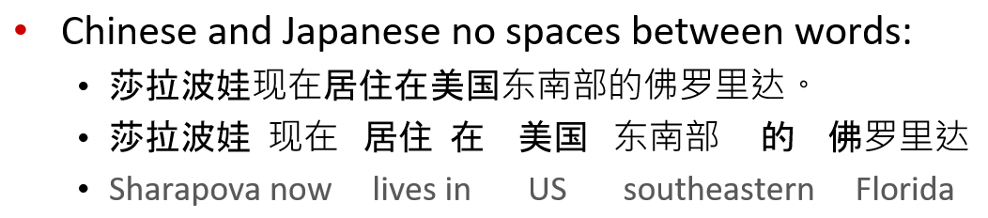
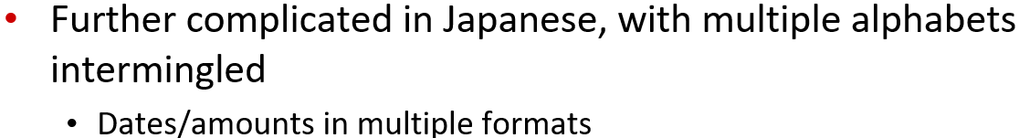
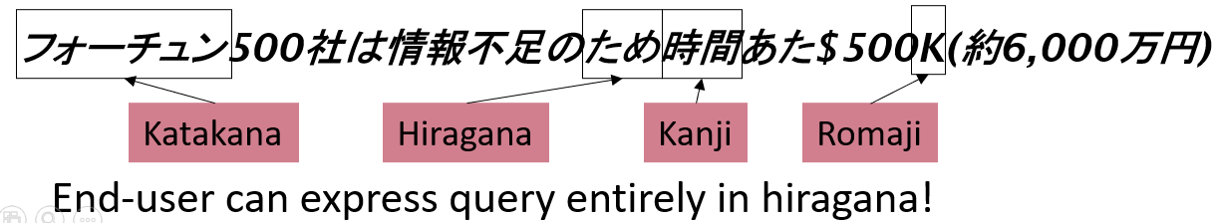

Slide 26
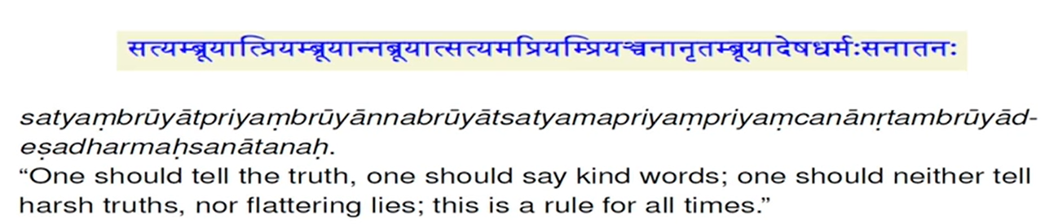
Sanskrit

Slide 27
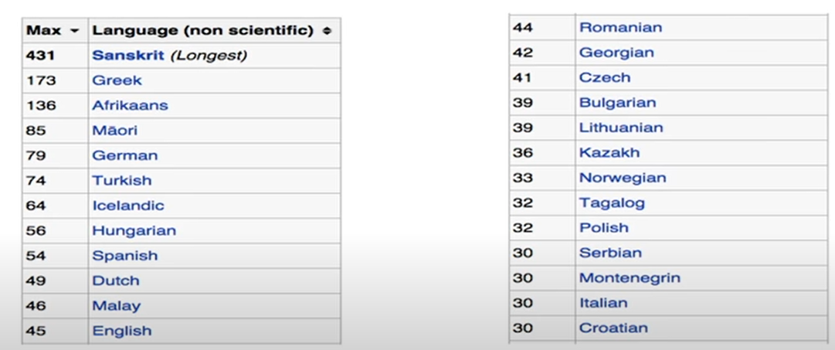
Longest word Source (Wikipedia)

Slide 28
Text Normalization
A single word can be written in multiple ways.
Every NLP task needs to do text normalization:
Segmenting/tokenizing words in running text
Normalizing word formats
Segmenting sentences in running text

Slide 29
Normalization
Need to “normalize” terms
Information retrieval : indexed text and query terms must have same form.
We want to match U.S.A and USA
We implicitly define equivalence classes of terms
Example: deleting periods in a term like U.S.A to USA
Alternative: asymmetric expansion:
Enter: window Search: window, windows
Enter : windows Search: Windows, windows, window
Enter : Windows Search : Windows

Slide 30
Case folding
For applications like IR: reduce all letters to lower case
Since users tend to use lower case
Possible exception: upper case in mid-sentence?
E.g. General Motors
Fed vs fed
SAIL vs sail
For sentiment analysis, MT, information extraction
Case is helpful (US vs us is important)

Slide 31
Stemming
Reduce terms to their stems
Stemming is crude chopping of affixes
e.g. automate(s), automatic, automation all reduced to automat

Slide 32
POS tags
The significance of parts-of-speech (also known as POS, word classes, morphological classes, or lexical tags) for language processing is the large amount of information they give about a word and its neighbors.
Eight parts-of-speech: noun, verb, pronoun, preposition, adverb, conjunction, participle, and articles.
More recent lists of parts-of-speech (or tagsets) have many more word classes; 45 for the Penn Treebank (Marcus et al., 1993), 87 for the Brown corpus (Francis, 1979; Francis and Kucera, 1982), and 146 for the C7 tagset (Garside et al., 1997).

Slide 33
Lemmatization
Reduces inflections or variant forms to base form
Am, are, is-> be
Car, cars, car’s, cars’-> car
The boy’s cars are different colours-> the boy car be different colour
Lemmatization : have to find correct dictionary headword form
Machine translation
Spanish quiero(‘I want’), quieres(‘you want’) same lemma as querer ‘want’

Slide 34
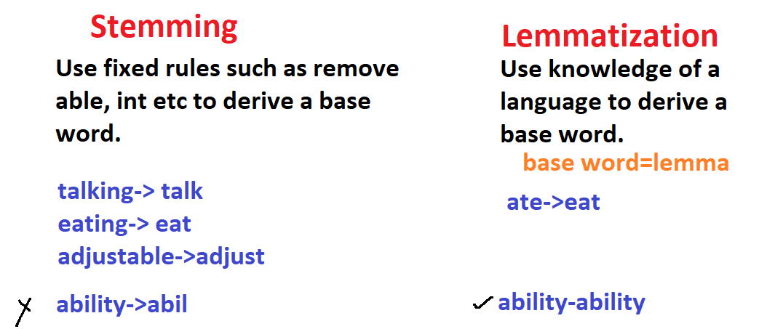

Slide 35
Identifying of stop words
Stop words are the commonly used words and are removed from the text as they do not add any value to the analysis.
These words carry less or no meaning.
NLTK library consists of a list of words that are considered stop words for the English language. Some of them are : [i, me, my, myself, we, our, ours, ourselves, you, you’re, you’ve, you’ll, you’d, your, yours, yourself, yourselves, he, most, other, some, such, no, nor, not, only, own, same, so, then, too, very, s, t, can, will, just, don, don’t, should, should’ve, now, d,m, o, re, y, aren’t, could, couldn’t, didn’t, didn’t]
But it is not necessary to use the provided list as stop words as they should be chosen wisely based on the project.

Slide 36
Filtering
When we know what stop words are, we can use them to filter out from a given sentence.
Filtering is the process of removing stop words or any unnecessary data from the sentence.

Slide 37
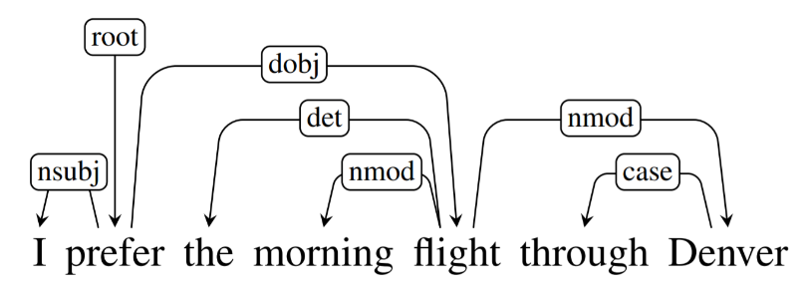
Dependency parsing
The term Dependency Parsing (DP) refers to the process of examining the dependencies between the phrases of a sentence in order to determine its grammatical structure. A sentence is divided into many sections based mostly on this. The process is based on the assumption that there is a direct relationship between each linguistic unit in a sentence. These hyperlinks are called dependencies.
Consider the following statement: “I prefer the morning flight through Denver.”

Slide 38
Noun phrases
An English noun phrase can have determiners, numbers, quantifiers, and adjective phrases preceding the head noun, which can be followed by a number of postmodifiers.
Named Entity Recognition (NER)
Named Entity Recognition (NER) involves identifying entities such as places, names, objects.
Coreference resolution
Coreference resolution tries to resolve pronouns (he,they etc) to the correct entities.

Slide 39
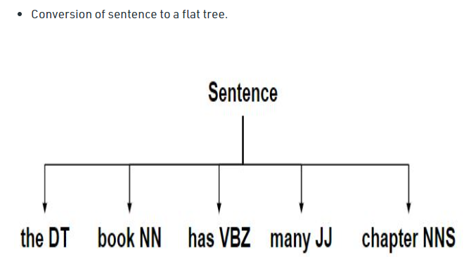
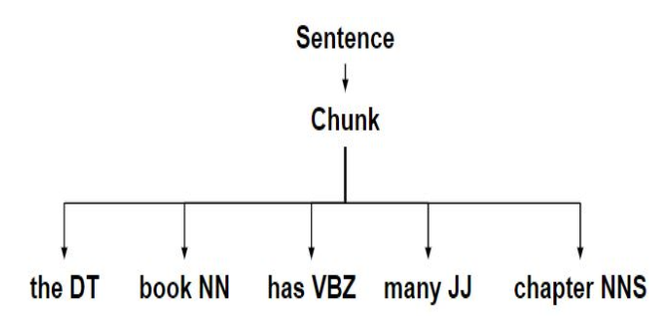
Chunking
Chunking is the process of identifying and classifying the flat, non-overlapping segments of a sentence that constitute the basic non- recursive phrases corresponding to the major parts of speech found in most wide coverage grammars.

Slide 40
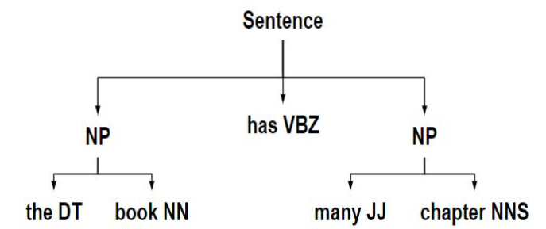
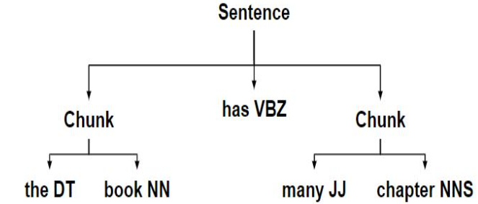

Slide 41
Morphology

Slide 42
Morphology
Morphology studies the internal structure of words, how words are built up from smaller meaningful units called morphemes.
cats
2 morphemes , cat and s
‘s’ is a plural marker on nouns
unladylike
3 morphemes
un-’not’
lady ‘well- behaved woman’
- like ‘ having the characteristic of’

Slide 43
Morphology
Morphology is the study of the way words are built up from smaller meaning-bearing units called morphemes.
Two broad classes of morphemes can be distinguished:
Stems: the central morpheme of the word, supplying the main meaning
Affixes : adding “additional”meanings of various kinds.
e.g the word fox consists of one morpheme (the morpheme fox) and the word cats consists of two: the morpheme cat and the morpheme -s.
A morphological parser takes a word like cats and parses it into the
two morphemes cat and s.

Slide 44
Morphology
Morphology is the study of words.
Morphemes are the minimal units of words that have a meaning and cannot be subdivided further.
There are two main types: free and bound.
Free morphemes can occur alone and bound morphemes must occur with another morpheme.
An example of a free morpheme is "bad", and an example of a bound morpheme is "ly.“ It is bound because although it has meaning, it cannot stand alone. It must be attached to another morpheme to produce a word. Free morpheme: bad Bound morpheme: -ly Word: badly

Slide 45
Morpheme
Morpheme is the smallest indivisible unit of semantic content and grammatical function.
Morpheme is the minimal unit of a language which has a meaning,lexical or grammatical, and cannot be divided into further smaller units.
They are the minimal building blocks of meaning.

Slide 46
Free Morpheme
Free morphemes are those that can stand alone as words and can function independently.
For Example: cat, boat, on, in etc.
Free morphemes are examples of ‘lexical morphemes’.
They are nouns, adjectives, verbs,prepositions or adverbs.
Such morphemes carry most of the ‘semantic content’ of utterances.

Slide 47
Bound Morpheme
Bound morphemes are those that can occur only in combination, i.e. they are parts of a word.
Bound morphemes always appear in conjunction with a root and sometimes with other bound morphemes.
For Example: -s, -er, -ing, -ment etc.

Slide 48
Some morphemes like boy, desire, gentle, and man may constitute words by themselves.
These are free morphemes.
Other morphemes like -ish, -ness, -ly, pre-, trans-, and un- are never words by themselves but are always parts of words.
These affixes are bound morphemes.

Slide 49
Types of morphemes
Allomorphs
Variants of the same morpheme, but can not be replaced by one another.
Example: opposite:
un-happy
in-comprehensible
im- possible
ir- rational
Bound and free morphemes
Bound
can not appear as a word by itself
-s (dog-s), -ly (quick-ly), -ed (walk-ed)

Slide 50
2. Free morphemes
Can appear as a word by itself; often can combine with other morphemes too.
eg. house (house-s), walk (walk-ed), of, the, or

Slide 51
Stems and affixes
Stems (roots): The core meaning bearing units
Affixes : Bits and pieces adhering to stems to change their meanings and grammatical functions
*Mostly, stems are free morphemes and affixes are bound morphemes.

Slide 52
Types of affixes
1. Prefix : precede the stem
In English->un-, anti- etc
In Sanskrit ->a-, ati-, pra-
e.g. un-happy, pre- existing
2. Suffix : follow the stem
In English-> -ity, -ation etc
In Hindi -> -taa, -ke, -ka etc
e.g. talk-ing, quick-ly
3. circumfixes: do both
In German, the past participle of some verbs is formed by adding ge- to the beginning of the stem and -t to the end; so the past participle of the verb sagen (to say) is gesagt (said).
4. infix: inserted inside the stem
In Sanskrit: ‘n’ in vindati (he knows), as contrasted with vid (to know)

Slide 53
A word can have more than one affix.
eg. Rewrites(re-, write), unbelievably( un- , -able, -ly)

Slide 54
There are many ways to combine morphemes to create words.
There are 4 methods which are common in speech and language processing:
Inflection
Derivation
Compounding
Cliticization

Slide 55
Inflectional and Derivational Morphology

Slide 56
Open class words and Closed class words
Two groups: lexical (or content) and function (or grammatical) words.
Lexical words are called open class words and include nouns, verbs, adjectives and adverbs.
New words can regularly be added to this group.
Function words, or closed class words, are conjunctions, prepositions, articles and pronouns; and new words cannot be (or are very rarely) added to this class.

Slide 57
Some word classes are OPEN, that is, new words can be added to the class as the need arises.
The class of nouns, for instance, is potentially infinite, since it is continually being expanded as new scientific discoveries are made, new products are developed, and new ideas are explored.
In the late twentieth century, for example, developments in computer technology have given rise to many new nouns:
Internet, website, URL, CD-ROM, email, newsgroup, bitmap, modem, multimedia
New verbs have also been introduced:
download, upload, reboot, right-click, double-click

Slide 58
On the other hand, we never invent new prepositions, determiners, or conjunctions.
These classes include words like of, the, and but.
They are called CLOSED word classes because they are made up of finite sets of words which are never expanded .
The subclass of pronouns, within the open noun class, is also closed.

Slide 59
Types of Morphology
Inflectional Morphology
Derivational Morphology

Slide 60
Types of Morphology
Inflectional morphology:
modification of a word to express different grammatical categories.
Examples
cats, men etc.
Derivational Morphology:
creation of a new word from existing word by changing grammatical category.
Examples
happiness, brotherhood etc.

Slide 61
Inflectional Morphology
Inflectional morphology is the study of the processes that distinguish the forms of words in certain grammatical categories.
This includes processes such as affixation and vowel change, which create inflectional morphemes.
An inflectional morpheme is a suffix that’s added to a word to assign a particular grammatical property to that word, such as its number, mood, tense, or possession.

Slide 62
However, an inflectional morphology can never change the grammatical category of a word.
You can add an inflectional morphology to a verb, noun, adjective, or an adverb.
For example, adding a ‘-s’ to the verb plural verb ‘run’ can make this verb singular.
Similarly, adding ‘-ed’ to the verb dance creates the past tense of the verb (danced).

Slide 63
Some examples are as follows:
Cat | → | Cats
Teach | → | Teaches
Clean | → | Cleaned
Pretty | → | Prettier

Slide 64
Inflectional morphemes usually produce different forms of the same word, instead of different words.
Inflection does not generally change the basic meaning of a word as they only add specifications to a word or emphasize certain aspects of its meaning.
Words under inflectional morphology are not found as separate entries in dictionaries.

Slide 65
In English there are only eight total inflectional affixes:

Slide 66
-s | 3rd person singular present | she waits
-ed | past tense | he walked
-ing | progressive | she's watching
-en | past participle | she has eaten
-s | plural | three tables
-'s | possessive | Holly's cat
-er | comparative | you are taller
-est | superlative | you are the tallest

Slide 67
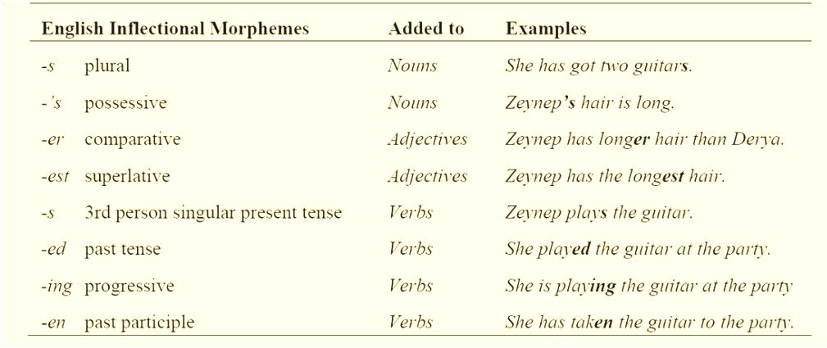

Slide 68
Inflectional morphology
Grammatical : number, tense, case, gender
Creates new forms of the same word
eg. Bring, brought, brings, bringing

Slide 69
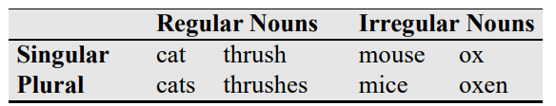
English has relatively simple inflectional system:
nouns, verbs, sometimes adjectives can be inflected.
A. English noun has two kinds of inflection:
An affix that marks plural and an affix that marks possessive.
Singular and plural
2. Possessive suffix (apostrophe + -s)
e.g. Emma’s, children’s, llamas’

Slide 70
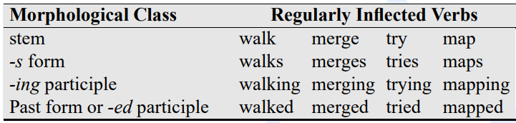
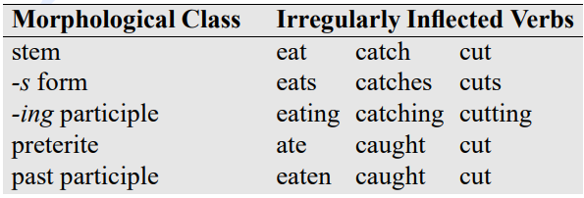
B. English has three kinds of verbs:
main verbs (eat, sleep)
modal verbs (can, will, should)
primary verbs (be, have, do)

Slide 71
Derivational Morphology
Derivational morphology is the study of the formation of new words that differ either in syntactic category or in meaning from their bases.
A derivational morpheme is an affix we add to a word in order to create a new word or a new form of a word.
A derivational morpheme can either change the meaning or the grammatical category of the word.

Slide 72
Derivational morphology
Derivation is the combination of a word stem with a grammatical morpheme, usually resulting in a word of a different class, often with a meaning hard to predict exactly.
A very common kind of derivation in English is the formation of new nouns, often from verbs or adjectives. This process is called nominalization.
Creates new words by changing part- of- speech
e.g. logic, logical, illogical, logician

Slide 73
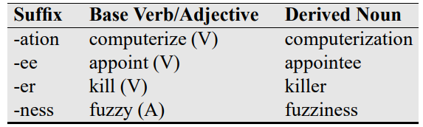
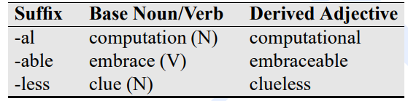
1. Verbs : The suffix -ation produces nouns from verbs ending often in the suffix -ize (computerize → computerization).
2. Adjectives can also be derived from nouns and verbs.

Slide 74
Morphological process
There are many processes. Some are:
Concatenation
Adding continuous affixes
e.g. hope+less, un_happy, anti+capital+ist+s
There are two types of changes in concatenation
Phonological
shoe+s [z]
b. graphemic
Happy+er-> happier

Slide 75
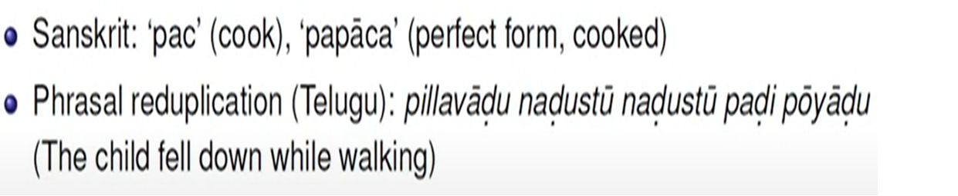
2. Reduplication
Part of the word or entire word is doubled

Slide 76
3. Suppletion
‘irregular’ relation between the words
e.g. go- went, good –better
4. Morpheme internal changes
The word changes internally
e.g. sing-sang-sung, man-men, goose-geese

Slide 77
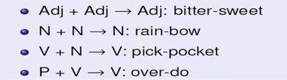
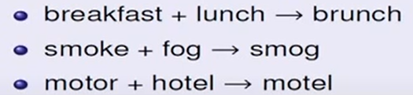
Word formation
Compounding
Words formed by combining two or more words
e.g.
B. Blending
Parts of two different words are combined

Slide 78
C. Clipping
Longer words are shortened
Doctor- doc
Laboratory-lab
Advertisement- ad
Dormitory- dorm
Examination- exam
Bicycle- cycle
Refrigerator- fridge

Slide 79
Processing morphology

Slide 80
Applications :
Text to speech synthesis
read: present or post?
Lead :verb or past?
Search and information retrieval
Machine translation, grammar correction

Slide 81
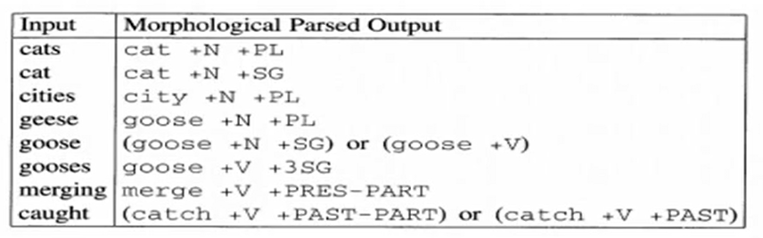
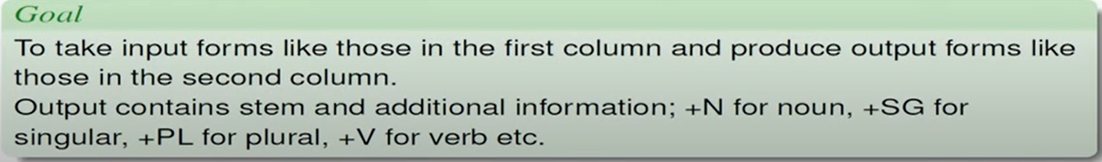
Morphological analysis

Slide 82
In order to build a morphological parser, we’ll need at least the following:
lexicon: The list of stems and affixes, together with basic information about them (whether a stem is a Noun stem or a Verb stem, etc.).
Morphotactic : The model of morpheme ordering that explains which classes of morphemes can follow other classes of morphemes inside a word. For example, the fact that the English plural morpheme follows the noun rather than preceding it is a morphotactic fact.
Orthographic rules: These spelling rules are used to model the changes that occur in a word, usually when two morphemes combine (e.g., the y → ie spelling rule discussed above that changes city + -s to cities rather than citys).

Slide 83
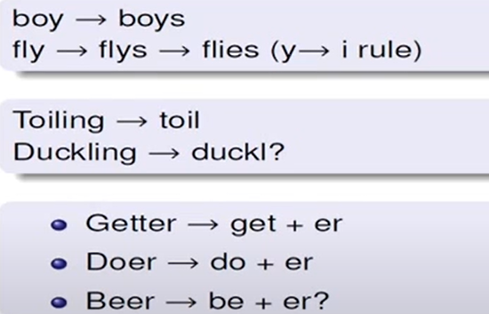
Issues involved

Slide 84
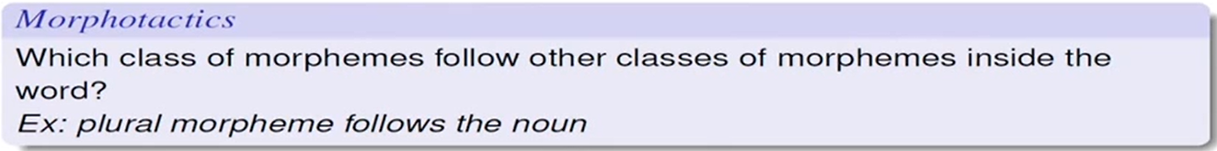
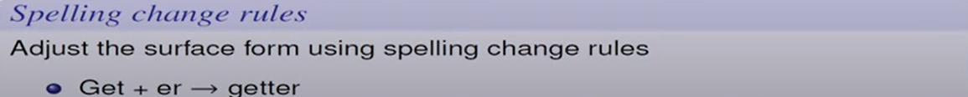
Things we must know

Slide 85
https://web.stanford.edu/~jurafsky/slp3/14.pdf
Quick Introduction to Smoothing Techniques for Language Models - Data Analytics (vitalflux.com)
NPTEL courses
Dan Jurafsky coursera
T1-Jurafsky.pdf: Chapter 2,3,4

